Slide 1
Backtracking

Slide 2
Introduction
Backtracking is a systematic way to iterate through all the possible configurations of a search space.
These configurations may represent all possible arrangements of objects (permutations) or all possible ways of building a collection of them (subsets).
Example: Enumerating all spanning trees of a graph, all paths between two vertices, etc.

Slide 3
We must generate each one possible configuration exactly once.
We must define a systematic generation order.

Slide 4
Steps Involved in Backtracking
The solution will be modeled as a vector a = (a1, a2, ..., an), where each element ai is selected from a finite ordered set Si.
The partial solution a = (a1, a2, ..., ak) is extended by adding another element at the end.
If the new partial solution is a solution to the problem then either we print, count, or apply some operation depending upon the application.
If not, we must check whether the partial solution is still potentially extendible to some complete solution.

Slide 5
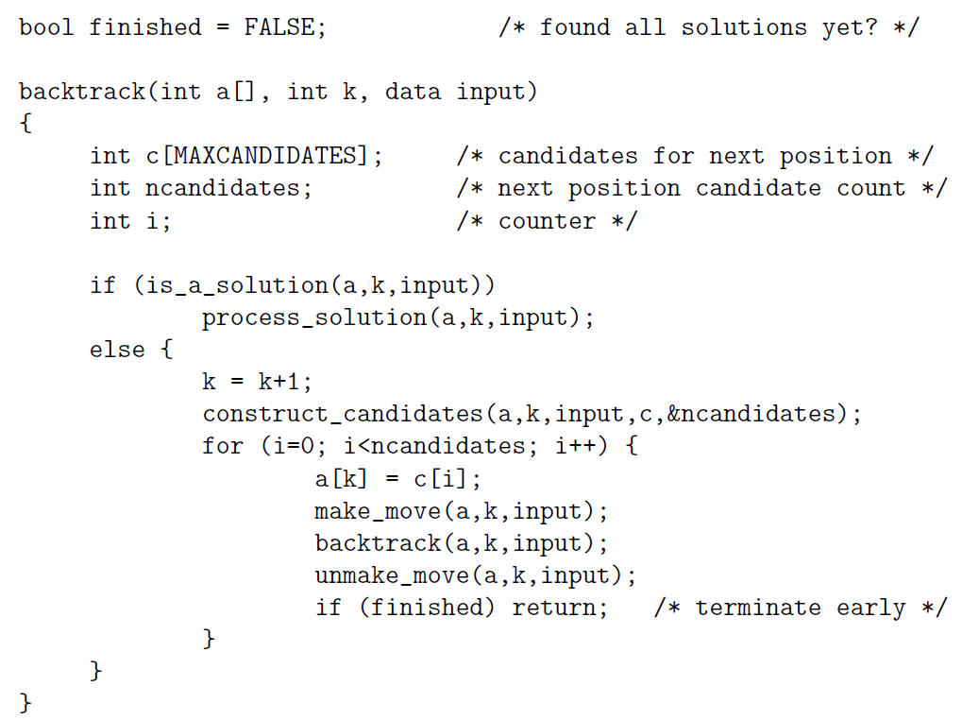
Backtrack Code

Slide 6
The application-specific parts of this algorithm consists of five subroutines:
is a solution(a, k, input) – This Boolean function tests whether the first k elements of vector a from a complete solution for the given problem. The last argument, input, allows us to pass general information into the routine. We can use it to specify n—the size of a target solution.
construct candidates(a, k, input, c, ncandidates) – This routine fills an array c with the complete set of possible candidates for the kth position of a, given the contents of the first k − 1 positions. The number of candidates returned in this array is denoted by ncandidates. Again, input may be used to pass auxiliary information.

Slide 7
process solution(a,k,input) – This routine prints, counts, or however processes a complete solution once it is constructed.
make move(a,k,input) and unmake move(a,k,input) – These routines enable us to modify a data structure in response to the latest move, as well as clean up this data structure if we decide to take back the move.

Slide 8
Although a breadth-first search could also be used to enumerate solutions, a depth-first search is greatly preferred because it uses much less space.
Backtracking ensures correctness by enumerating all possibilities. It ensure efficiency by never visiting a state more than once.
A new candidates array c is allocated with each recursive procedure call.

Slide 9
Constructing All Subsets
There are 2^{n} subsets of n elements.
To construct all 2^{n} subsets, an array/vector of n cells, where the value of ai (true or false) signifies whether the ith item is in the given subset.
In the scheme of our general backtrack algorithm, S_{k} = (true, false) and a is a solution whenever k = n.
We can now construct all subsets with simple implementations of is a solution(), construct candidates(), and process solution().

Slide 10
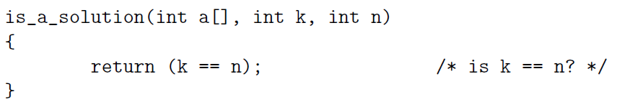
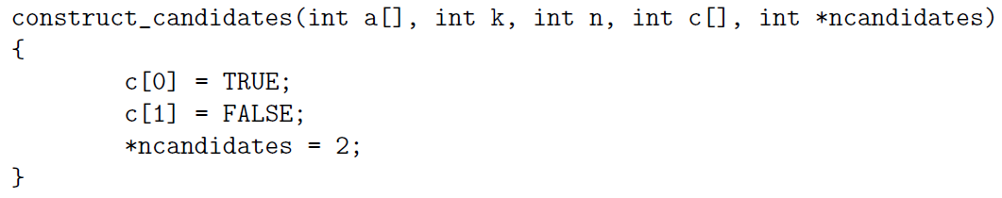
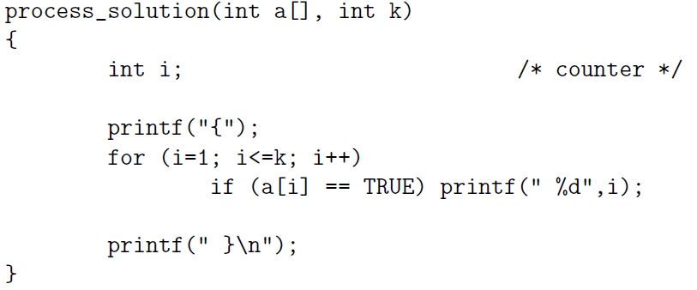

Slide 11
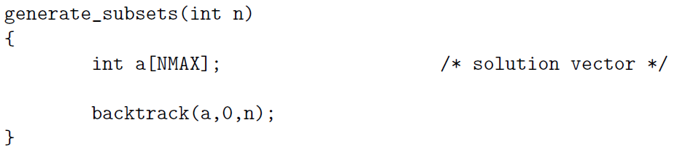
Finally, we must instantiate the call to backtrack with the right arguments.
Specifically, this means giving a pointer to the empty solution vector, setting k = 0 to denote that it is empty, and specifying the number of elements in the universal set.

Slide 12
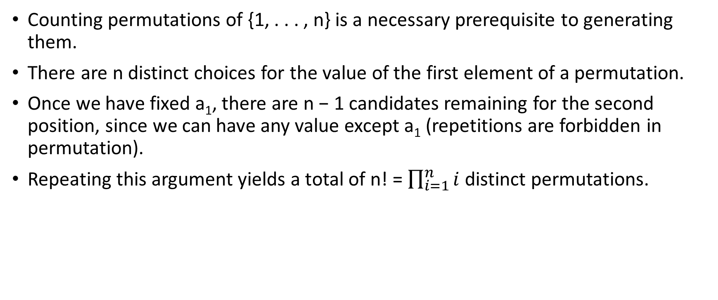
Constructing All Permutations
Counting permutations of {1, . . . , n} is a necessary prerequisite to generating them.
There are n distinct choices for the value of the first element of a permutation.
Once we have fixed a₁, there are n − 1 candidates remaining for the second position, since we can have any value except a₁ (repetitions are forbidden in permutation).
Repeating this argument yields a total of n! = $\prod_{i=1}^{n}{i}$ distinct permutations.

Slide 13
This counting argument suggests a suitable representation.
Set up an array/vector a of n cells.
The set of candidates for the i^{th} position will be the set of elements that have not appeared in the (i − 1) elements of the partial solution, corresponding to the first i − 1 elements of the permutation.
In the scheme of the general backtrack algorithm, Sk = {1, . . . , n}−a, and a is a solution whenever k = n:

Slide 14
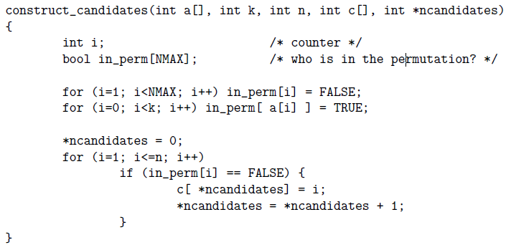

Slide 15
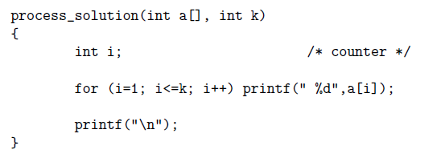
A bit-vector data structure (inPerm) is maintained to find which elements are in the partial solution.

Slide 16
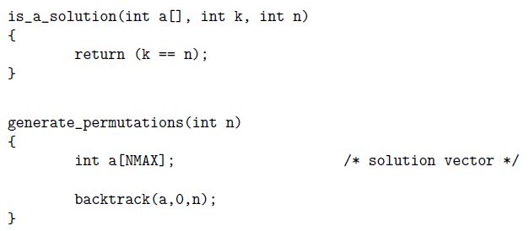
As a consequence of the candidate order, these routines generate permutations in lexicographic, or sorted order—i.e., 123, 132, 213, 231, 312, and 321.

Slide 17
Constructing All Paths in a Graph

